Slide 1

Elastic Stack Installation & Configuration
Anna Gassen, Ciara Goetze, James Gadson III
Team G Code
Notes:
ANNA
- HOWDY YALL
THERES A SNAKE IN MY BOOT
- Introduction: Team name, then individual introductions (first and last name, what school you go to), then project name
1

Slide 2
Objective
Install and configure Elastic Stack on the Academy clusters
Gather logs from all nodes
Develop some insightful searches
Research data analysis concepts
Notes:
CIARA
Here are the objectives we set for our team at the beginning of the project. Our main goal was to install and configure the Elastic Stack on all three Academy clusters. Using the Elastic Stack software we wanted to gather all log messages from those clusters onto one node, and then develop some insightful searches and visualizations to understand what sorts of log messages our clusters were creating. And during all of this we wanted to research data analysis concepts so that we could understand why filtering log messages and using the Elastic Stack is important to high performance computing. As you can see, our project was pretty open ended from the start. We didn’t have a goal other than figuring out what Elastic Stack does, and from there we figured how it would be useful in relation to the Academy’s own clusters.

Slide 3

Elastic Stack
You know, for search
Our clusters produce more than 1500 log messages per minute
Comprised of six open-source tools: Elasticsearch, Logstash, Kibana, Beats, X-Pack, Elastic Cloud
Allows quick analyzation, visualization, and mining of millions of log files
Identify trends, statistics, and abnormalities
Notes:
JAMES
Our clusters produce more than 1,500 log messages per minute. Since the start of this project we have gathered over 37 million log messages. We needed a tool to quickly analyze and understand those files, so we decided to use Elastic Stack – you know, for search!! The Elastic Stack is software stack comprised of six open-source tools: Elasticsearch, Logstash, Kibana, Beats, X-Pack, and Elastic Cloud. We ended up only using the first four. Together, Elastic Stack allows for quick analyzation, visualization, and mining large amounts of data to identify trends, statistics, and abnormalities. Some of you may know Elastic Stack under its previous name, ELK stack, and I’m sure many of you are familiar with Splunk, the log management tool used by the lab.

Slide 4


Logstash
Collects data from many different sources at the same time
Filters and parses each message, converts it into a common format for easier analysis
Aggregates and transports data to Elasticsearch (or the software of your choice)
Notes:
ANNA
So now we’ll go into more detail about what each piece of software in Elastic Stack does. The first is Logstash. Logstash collects data from many different sources at the same time, so not only can it collect nodes from our cluster, but also the other teams clusters, and from external sources such as Github and Twitter. It then filters and parses each messages to convert each one into a common format for easier analysis. The data is then aggregated and transported to Elasticsearch, where it is stored and can be queried. Logstash can also send its output to the software of your choice, for example Hadoop.

Slide 5


Filebeat
A lightweight log file shipping agent
Part of the Beats family of data shippers
Communicates directly with Logstash or Elasticsearch
Easily forwards and centralizes log files
Notes:
CIARA
The next software that we used was Filebeat which is a part of the Elastic Beats family of lightweight single purpose data shippers. Filebeat was created specifically to ship log files from many different nodes to Logstash or Elasticsearch. Unlike Logstash it doesn’t work with non-Elastic software. Logstash can do exactly what Filebeat does, but Filebeat is useful because it is a lightweight and easily to use method of forwarding and centralizing files to Logstash, which then can complete more complex filtering and outputting of those messages.
Beats is a family of single purpose lightweight data shippers
Use the photo as an example of how Logstash and Filebeat can work together, and also the difference between the two possibly?
Photo reference: https://www.elastic.co/products/beats/filebeat

Slide 6

Elasticsearch
Full-text search engine that searches and centrally stores data
Quickly find, retrieve, and analyze big volumes of data
Distributed and highly scalable
Near real time search
Uses RESTful API, JSON, and Lucene
Notes:
JAMES
Elasticsearch is the bread and butter of the Elastic Stack. It’s a full-text search engine based off of the Apache Lucene library that searches and centrally stores data. You can use it to quickly find, retrieve, and analyze high volumes of log messages. Elasticsearch is highly scalable, because you can easily add more clusters to your configuration, no matter if you’re working with a dozen nodes or a hundred. Another benefit of using Elasticsearch is that search is complete in near real time, so newly indexed documents are searchable within a second. Elasticsearch is built on a RESTful API used to interact with your clusters, JSON formatting to create log message documents, and the Lucene library to complete searches.

Slide 7

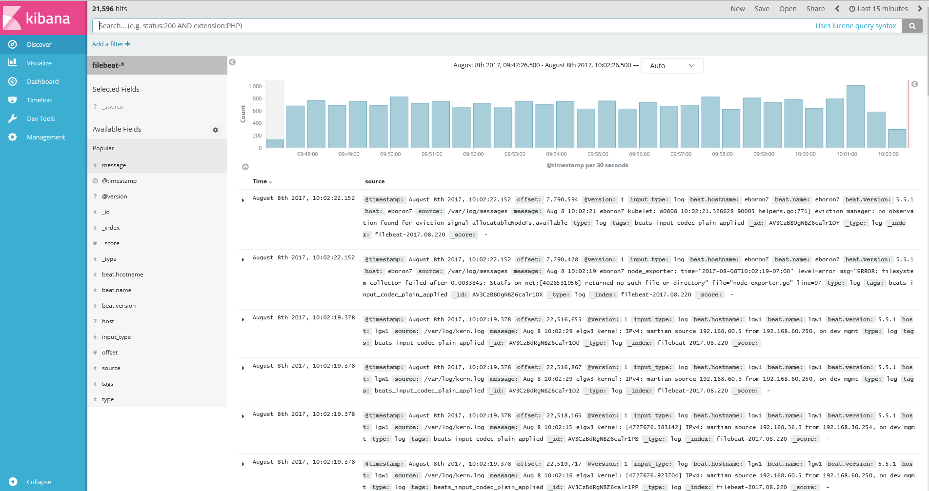
Kibana
Data visualization tool for log and time series analytics
Makes navigation and monitoring of logs more intuitive
Provides numerous graph and dashboard options to display information
Notes:
ANNA
The last part of Elastic Stack we used is Kibana, which is a data visualization tool for log messages and time series analytics. Through its web based interface, Kibana provides an easier more intuitive way to navigate and monitor the information stored in Elasticsearch. You then have the option to create visualizations ranging from bar graphs and pie charts to coordinate maps and tag clouds, depending on what displays your information in the best possible way. You can also create dashboards of important visualizations and searches that you frequently use. This picture is a screenshot of our Kibana discover page, which shows a bar graph of the number of documents indexed in the last 15 minutes, and a list below showing the most recent documents.

Slide 8
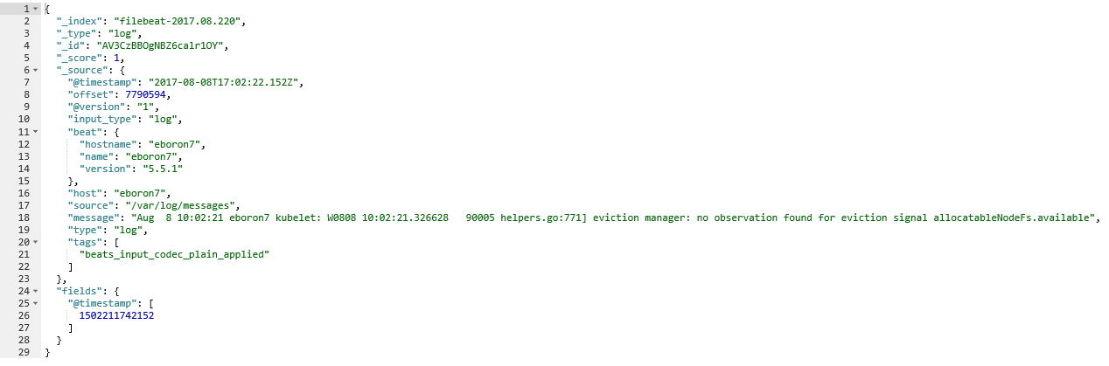
Notes:
CIARA
Here is an example of a document that is stored in Elasticsearch. It uses JSON formatting. The index groups relevant documents – we have it formatted to read filebeat, dash, the date that it was stored.

Slide 9
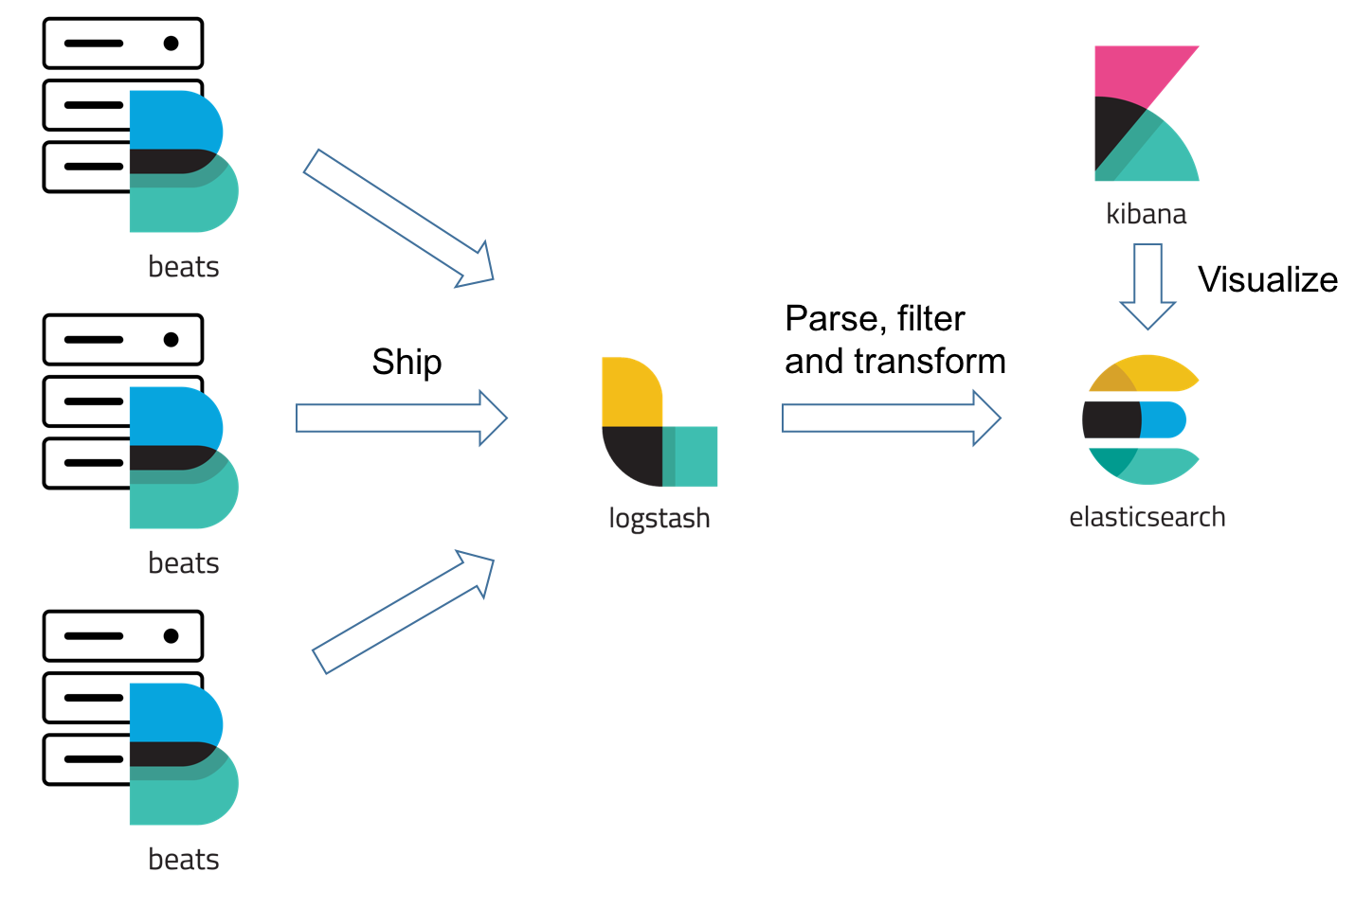
Notes:
JAMES GADSON IIIIIIIIIIIII
This is a visualization of how the Elastic Stack works together. Filebeat is installed on any cluster from which you want to receive log messages. Filebeat formats and ships the newly created documents to logstash. Logstash centralizes and filters the documents and sends the output to Elasticsearch. Elasticsearch stores the data that can now be searched. Kibana visualizes the data.
Photo reference: https://dzone.com/articles/filebeat-vs-logstash-the-evolution-of-a-log-shippe

Slide 10
Approach
86
Rn
Radon
222.018
5
B
lgw3
Boron
10.811
28
Ni
lgw2
lgw1
Nickel
58.6934
Notes:
ANNA

Slide 11
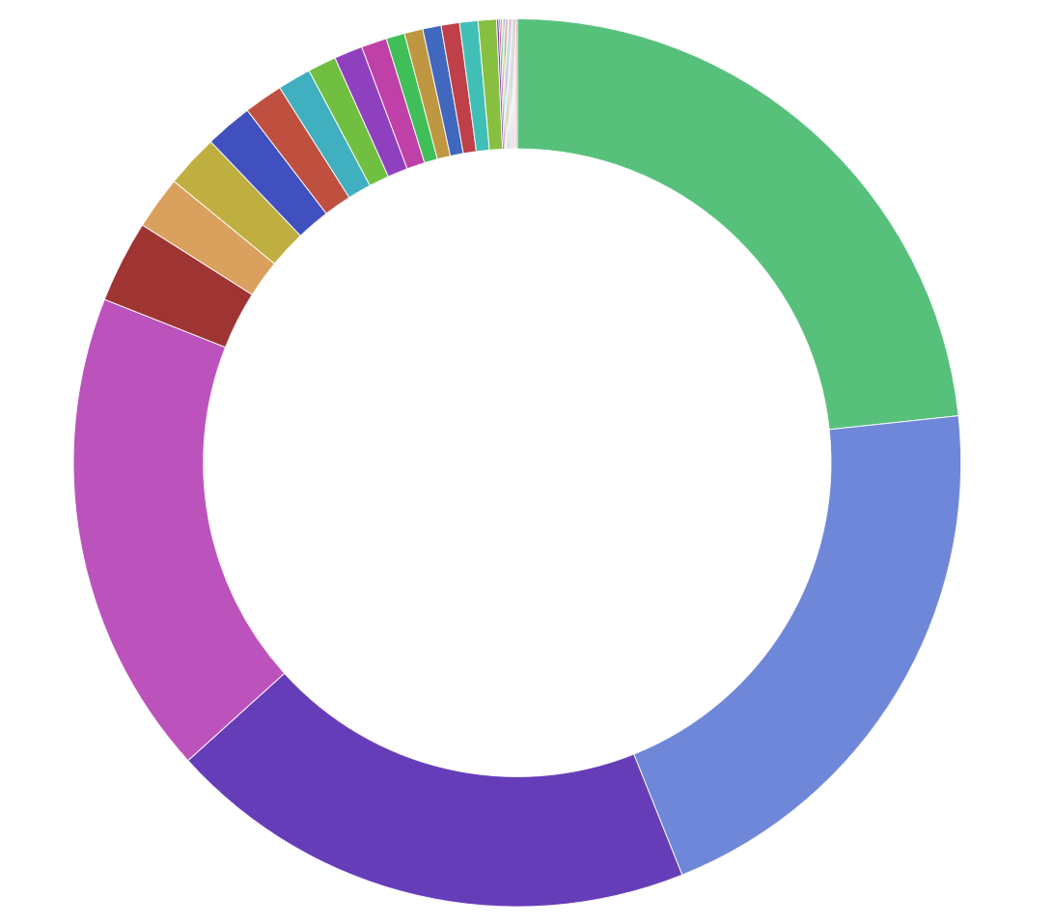
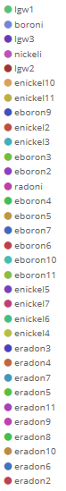
Number of Documents per Node
Notes:
CIARA
Now we’ll talk about and show some examples of the very first searches and visualizations we created with Kibana. The very first one we created was to show the number of documents received from each node. As you can see, the four biggest contributors of documents were the lgw1, lgw3, boroni, and nickeli. It would make sense for radoni to have contributed a similar number to the other management nodes in the Academy clusters, however during our installation and configuration process we lost a large portion of radoni’s documents. Filebeat thought it had already processed log files from before our project started, but only newly created messages were appearing. Therefore radoni has significantly less documents than boron or nickel. All the little slices are the various nodes in our clusters.

Slide 12
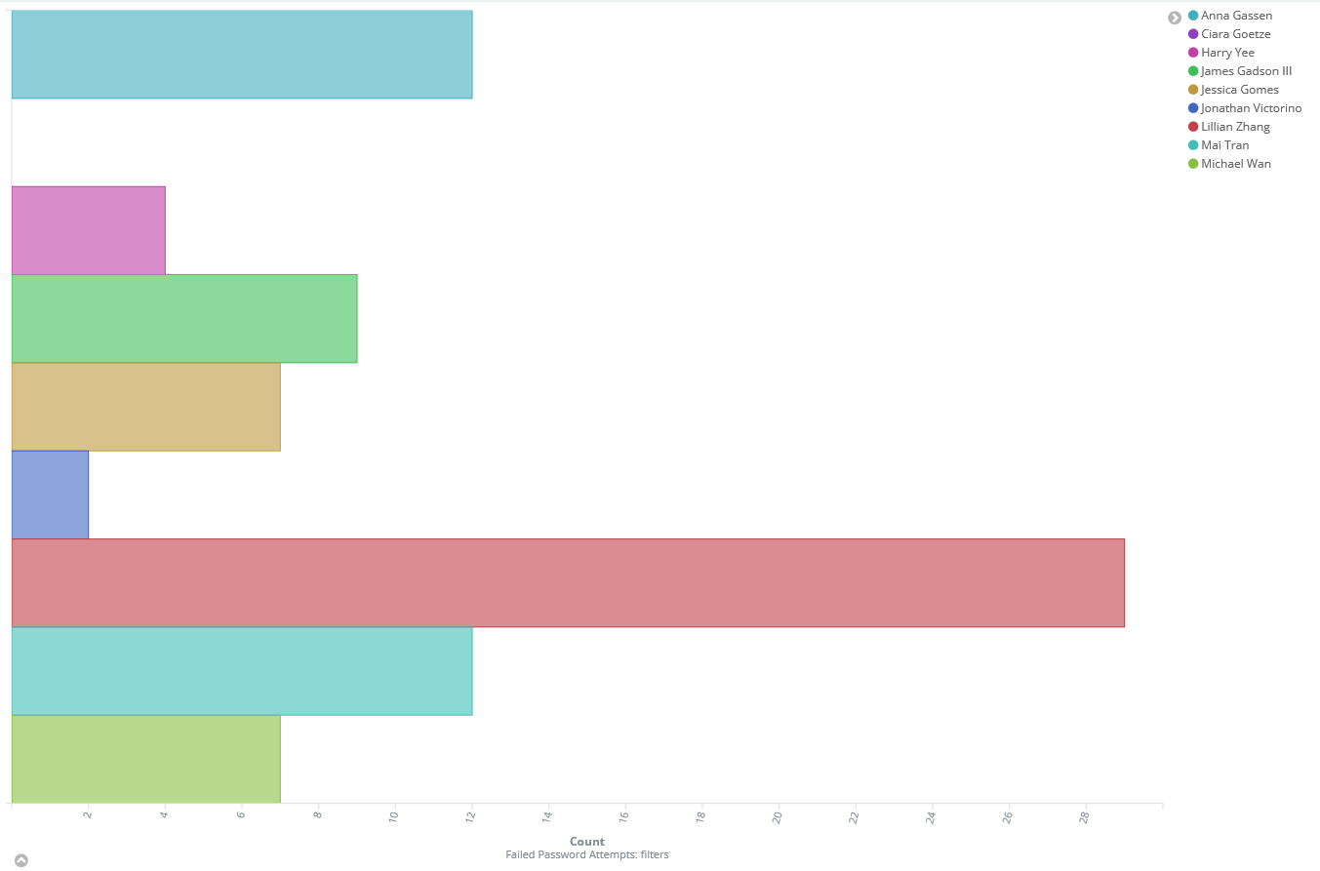
Failed Login Attempts
Notes:
JAMES
We thought it would be cool to do a search on the amount of failed login attempts to see who was the worst at typing in their password. From our research, we concluded that Lillian is by far the worst password typer of us all, and Ciara is clearly the best and most superior password typer of them all.

Slide 13
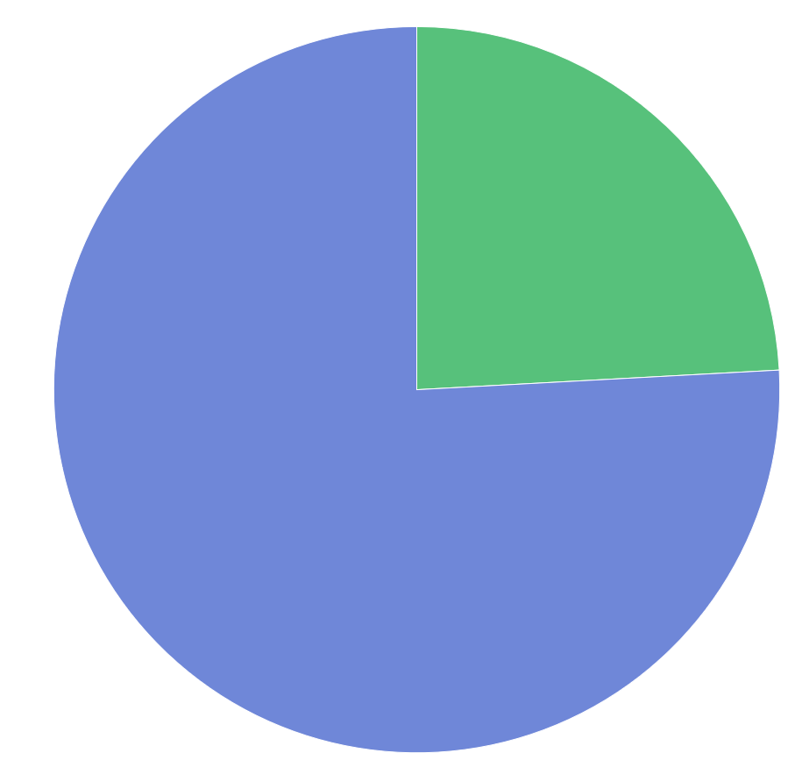
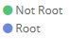
Root vs Non-Root Logins
Notes:
JAMES
This graph shows the number of sessions on our cluster, Radon, that were opened by the root user vs any other user. We logged in as root three times as often as we logged in as our own user accounts. Dave wanted us to publicly shame ourselves by showing this graph so here it is.

Slide 14
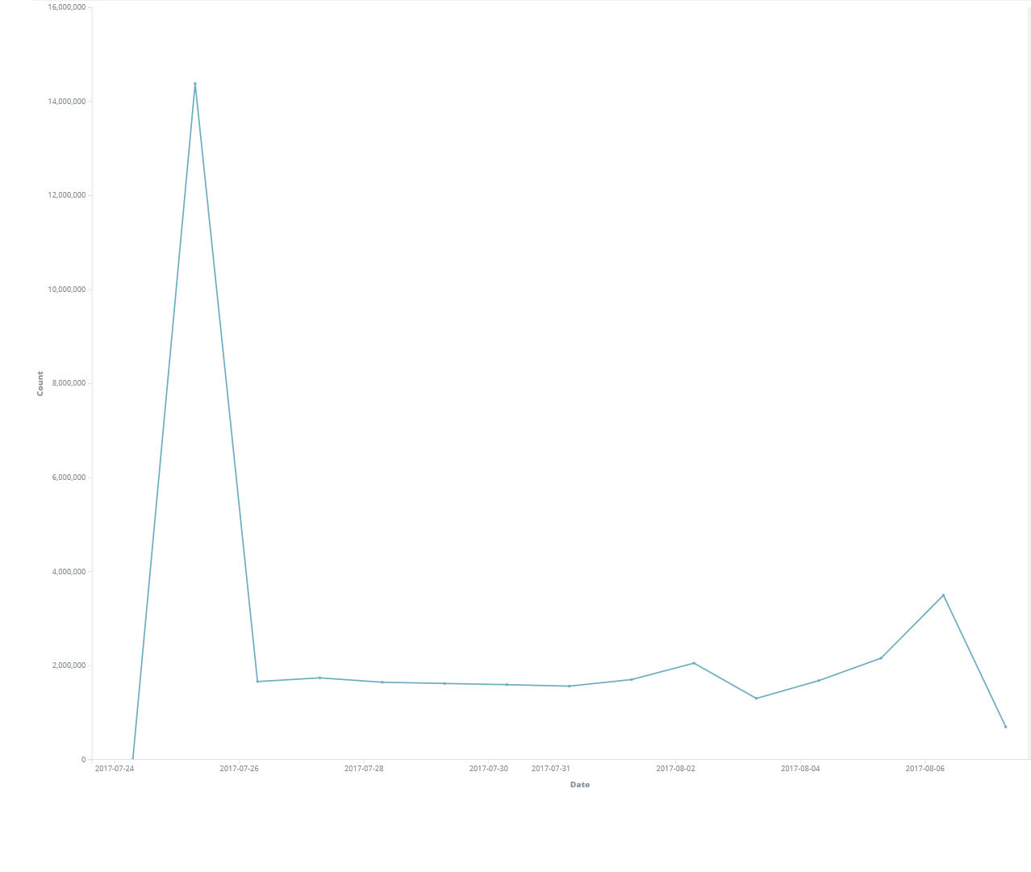
Number of Documents per Day
Notes:
ANNA
This visualization shows the number of documents indexed per day since the first day we started to look at our log files. July 26th is when we got the Elastic Stack configured on all our clusters, as you can see 14 million documents were created on that day because it was working through the backlog of files on our clusters. Then until August 3rd the number of documents created were from about 1.5 to 2 million daily. On August 3rd there was an increase in the number of documents because

Slide 15
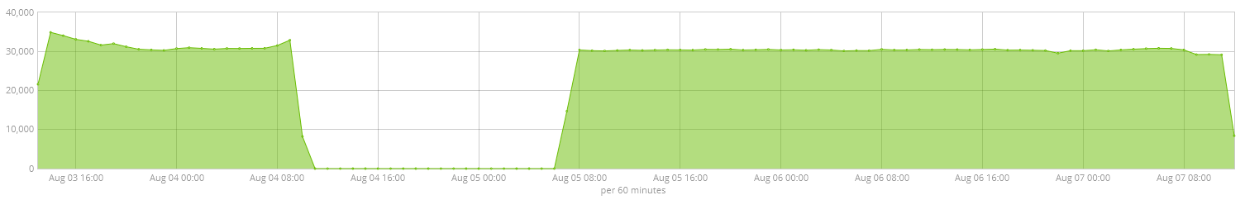
Martian Source Warnings
Notes:
CIARA
While many of our other visualizations were just basic searches we did manage to identify a problem our clusters using the Elastic Stack and were able to solve it. We found a martian source error that was basically getting logged every second. There’s a network switch that all of our clusters use, and that the gateway uses.

Slide 16
Future work
Research Logstash pipeline configuration options
Utilize Beats and X-Pack
Perform more complex Elasticsearch queries
Configuring Elastic Stack to be useful to future Academy interns

Slide 17
Acknowledgements
David Fox
Geoff Cleary
Pam Hamilton
Bryan Dixon
Richard Randall

